Slide 1
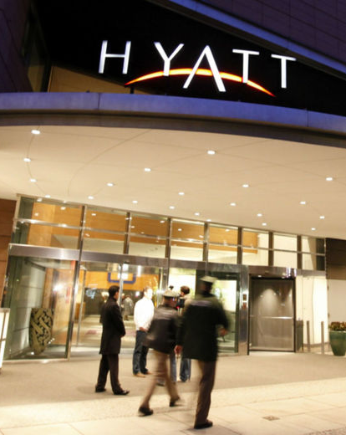
HYATT GROUP DATA ANALYSIS
IST 687
By,
Alyssa Bergman
Alexa Stathis
Chinmayee Parulekar
Vishwanath Hegde
Notes:
To change the image on this slide, select the picture and delete it. Then click the Pictures icon in the placeholder to insert your own image.

Slide 2
Scope
Hyatt Group data set had 13 GB data comprising of
236 attributes
15,711,552 variables
The goal of the exercise was to
Calculate NPS (Net Promoter) score
Analyse which data impacts NPS scores
Provide insights to increase NPS scores

Slide 3
Approach
Data Selection
We downloaded March, July & December 2014 data
Data Cleaning
Removed all rows where NPS type was NULL
Data Visualization
Modelling Techniques
Use of descriptive statistics and recommendations based on the data observed
Use of inferential statistics and recommendations based on the data observed

Slide 4
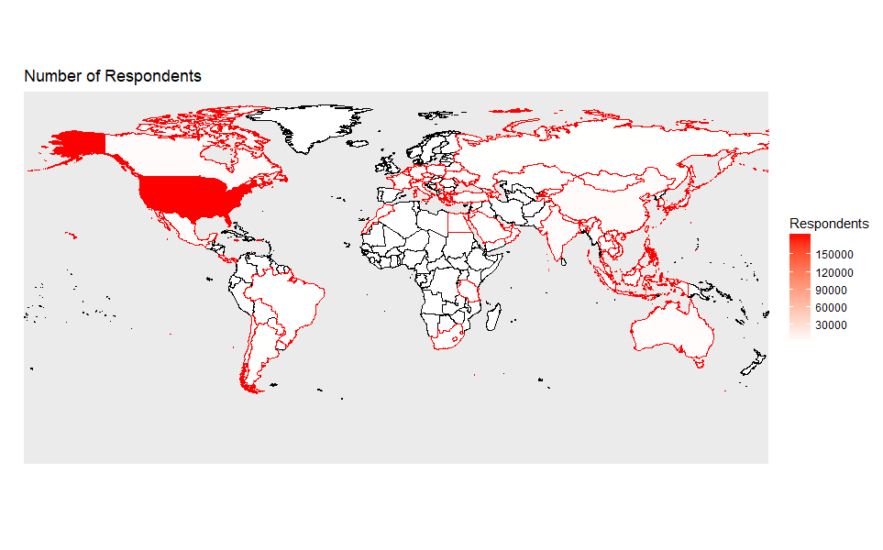
Map of Respondents Worldwide
USA has the highest number of Respondents

Slide 5
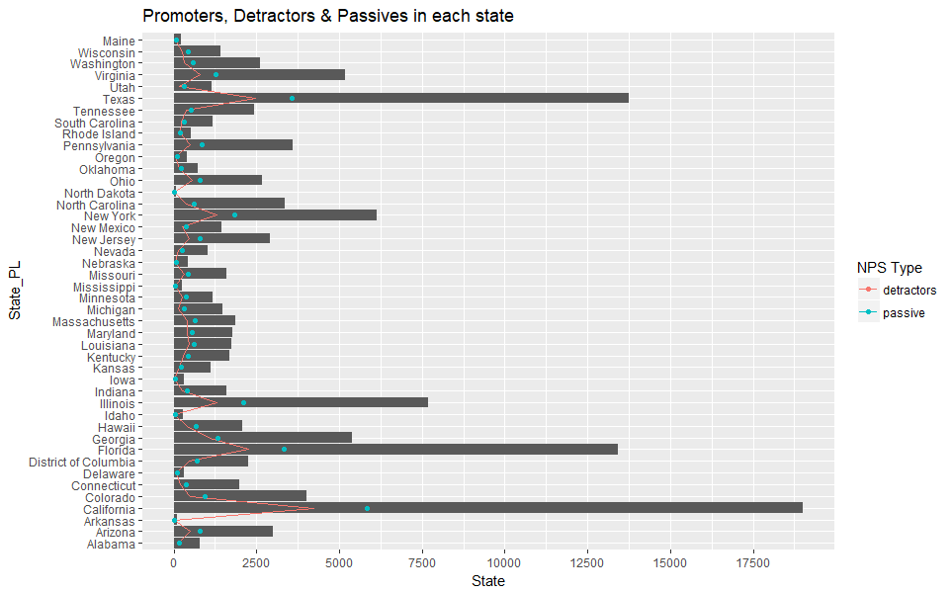
Statewise Distribution of Promoters, Detractors & Passives
California has the highest number of promoters and detractors
North Dakota has the lowest number of promoters and detractors
Opportunity lies in converting passives to promoters and reducing the number of detractors

Slide 6
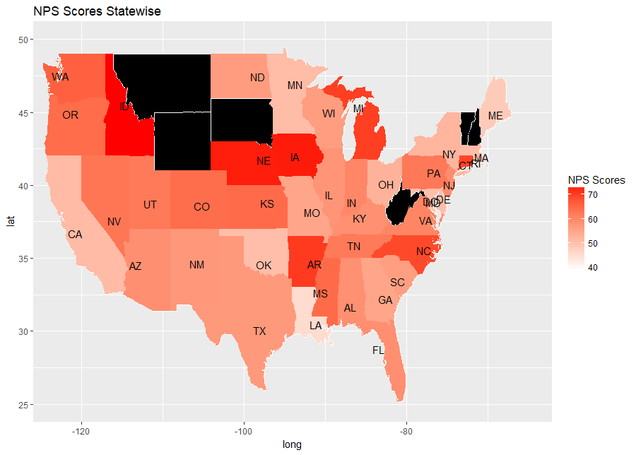
Overview of NPS Statewise
Nebraska, Idaho and Iowa have very high NPS scores
Texas, New Mexico and California have medium NPS scores
Louisiana, maine and Rhode island have the lowest NPS scores

Slide 7
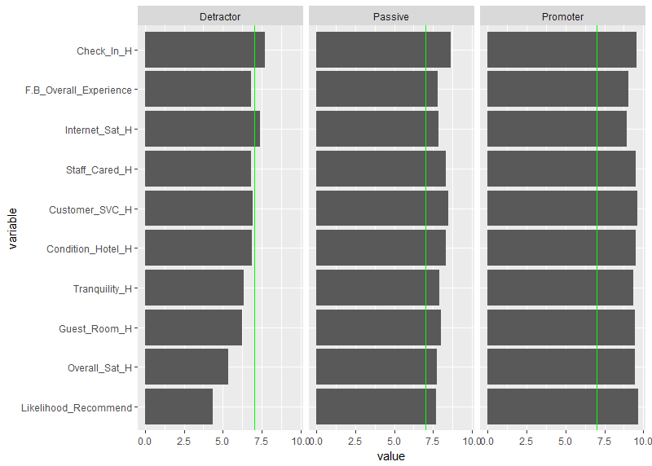
Overview of Ratings Based on NPS Type
Average ratings given by customers in USA based on NPS Type
Anything below the green line means dissatisfaction
Detractors are dissatisfied with staff care, condition of hotel, food & beverage experience, tranquilty and quality of guest room

Slide 8
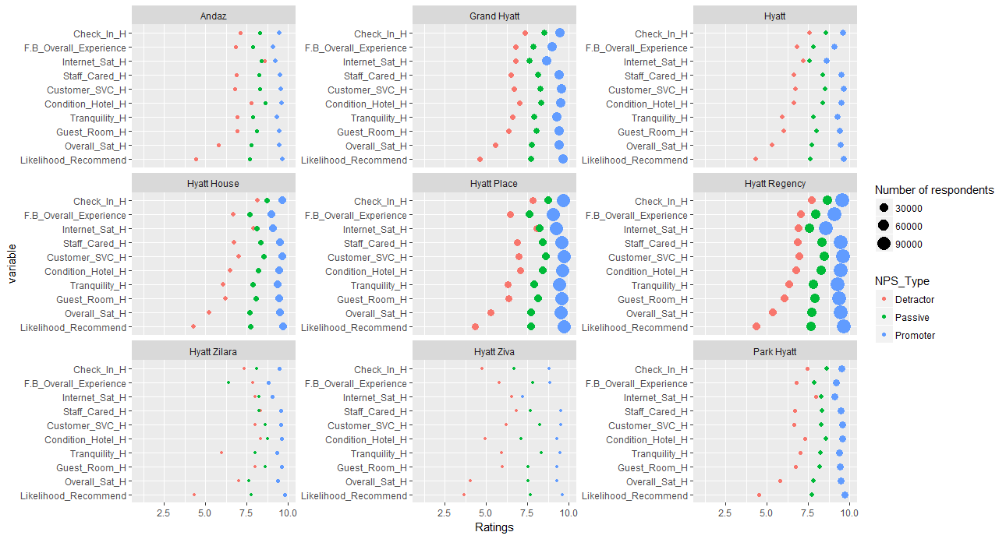
Overview of Average Ratings Based on Brands

Slide 9
FOCUS ON CALIFORNIA

Slide 10
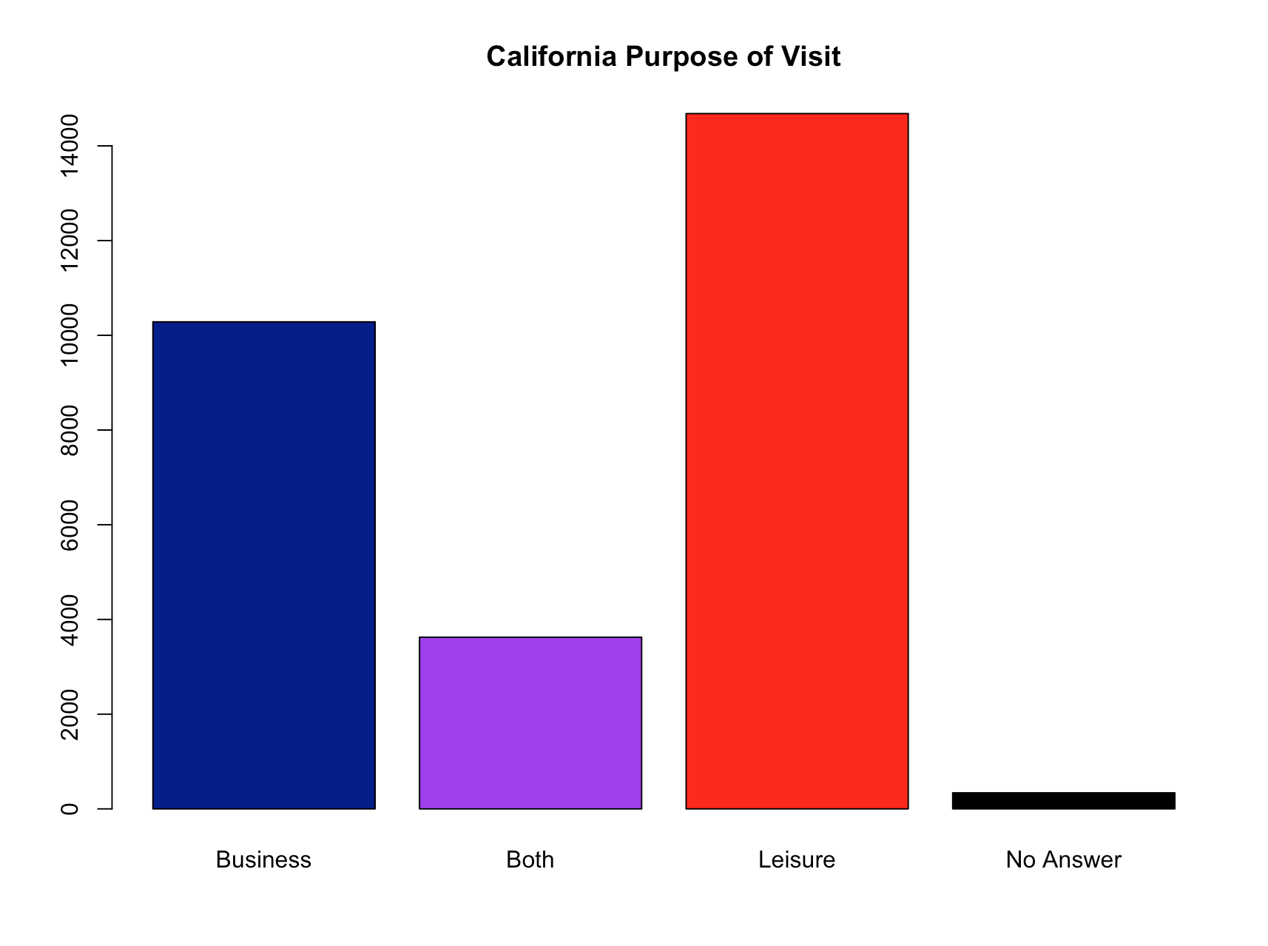
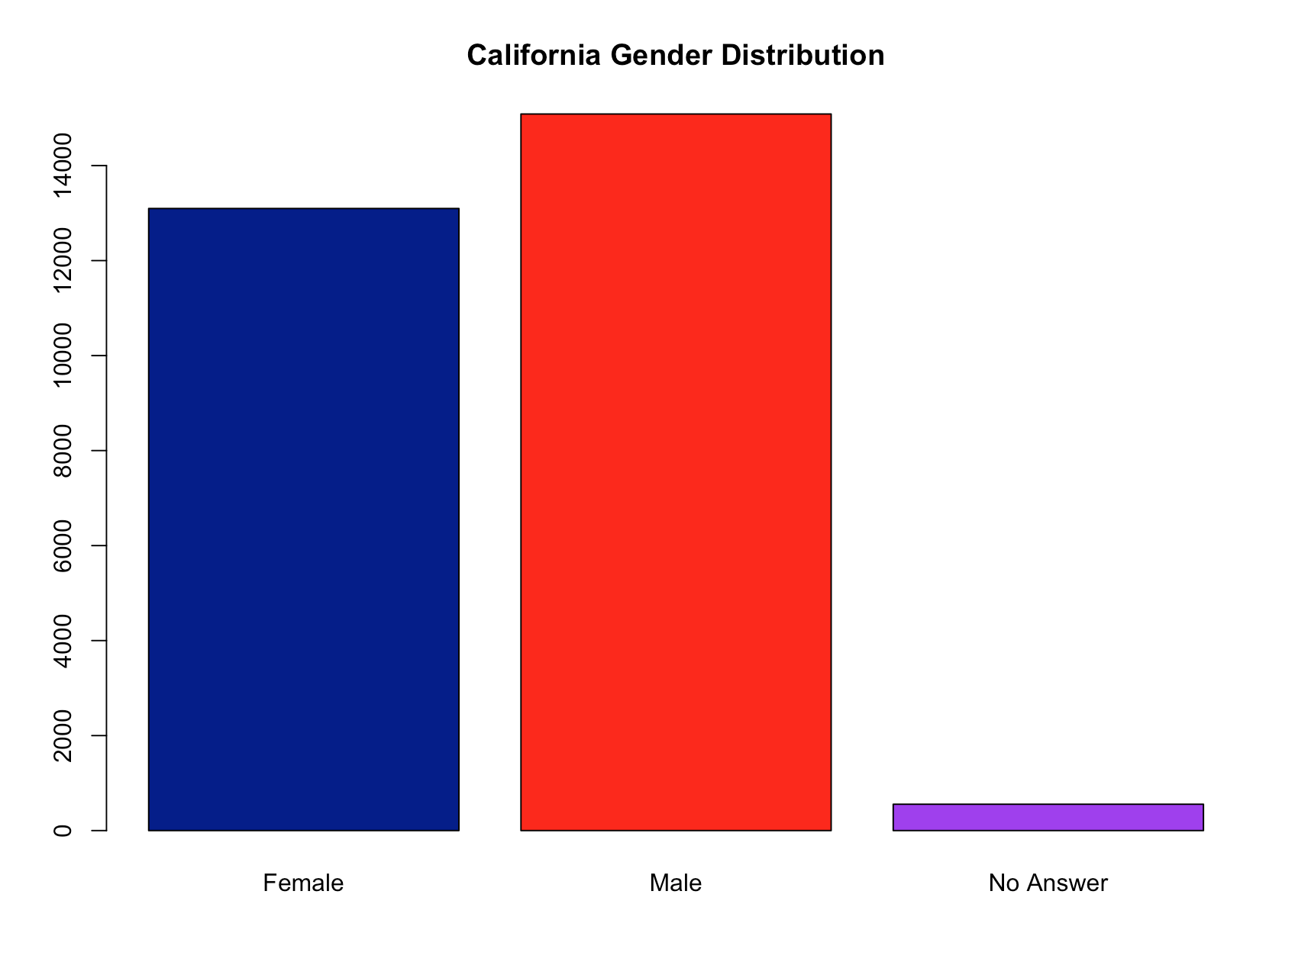
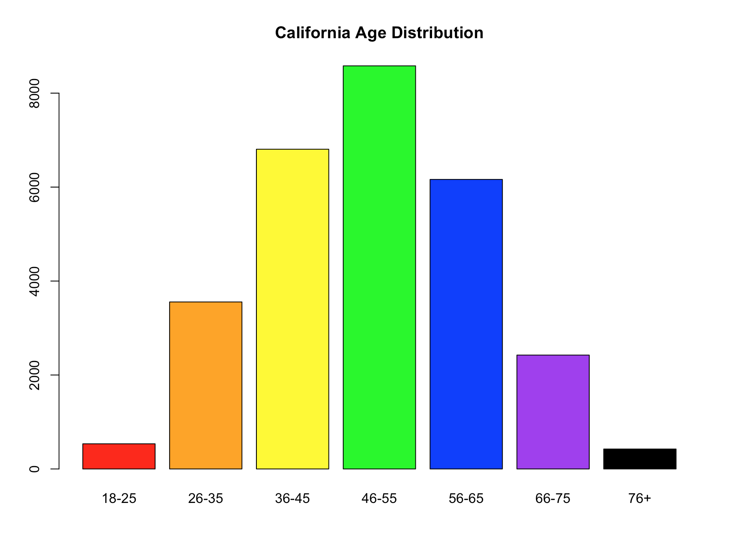
Overview of California (March, July & December )
More customers visited Hyatt hotels for leisure than for business
Hotels had more male visitors than females
More people in the age group 46-55 visited Hyatt hotels

Slide 11
MODELING TECHNIQUE

Slide 12
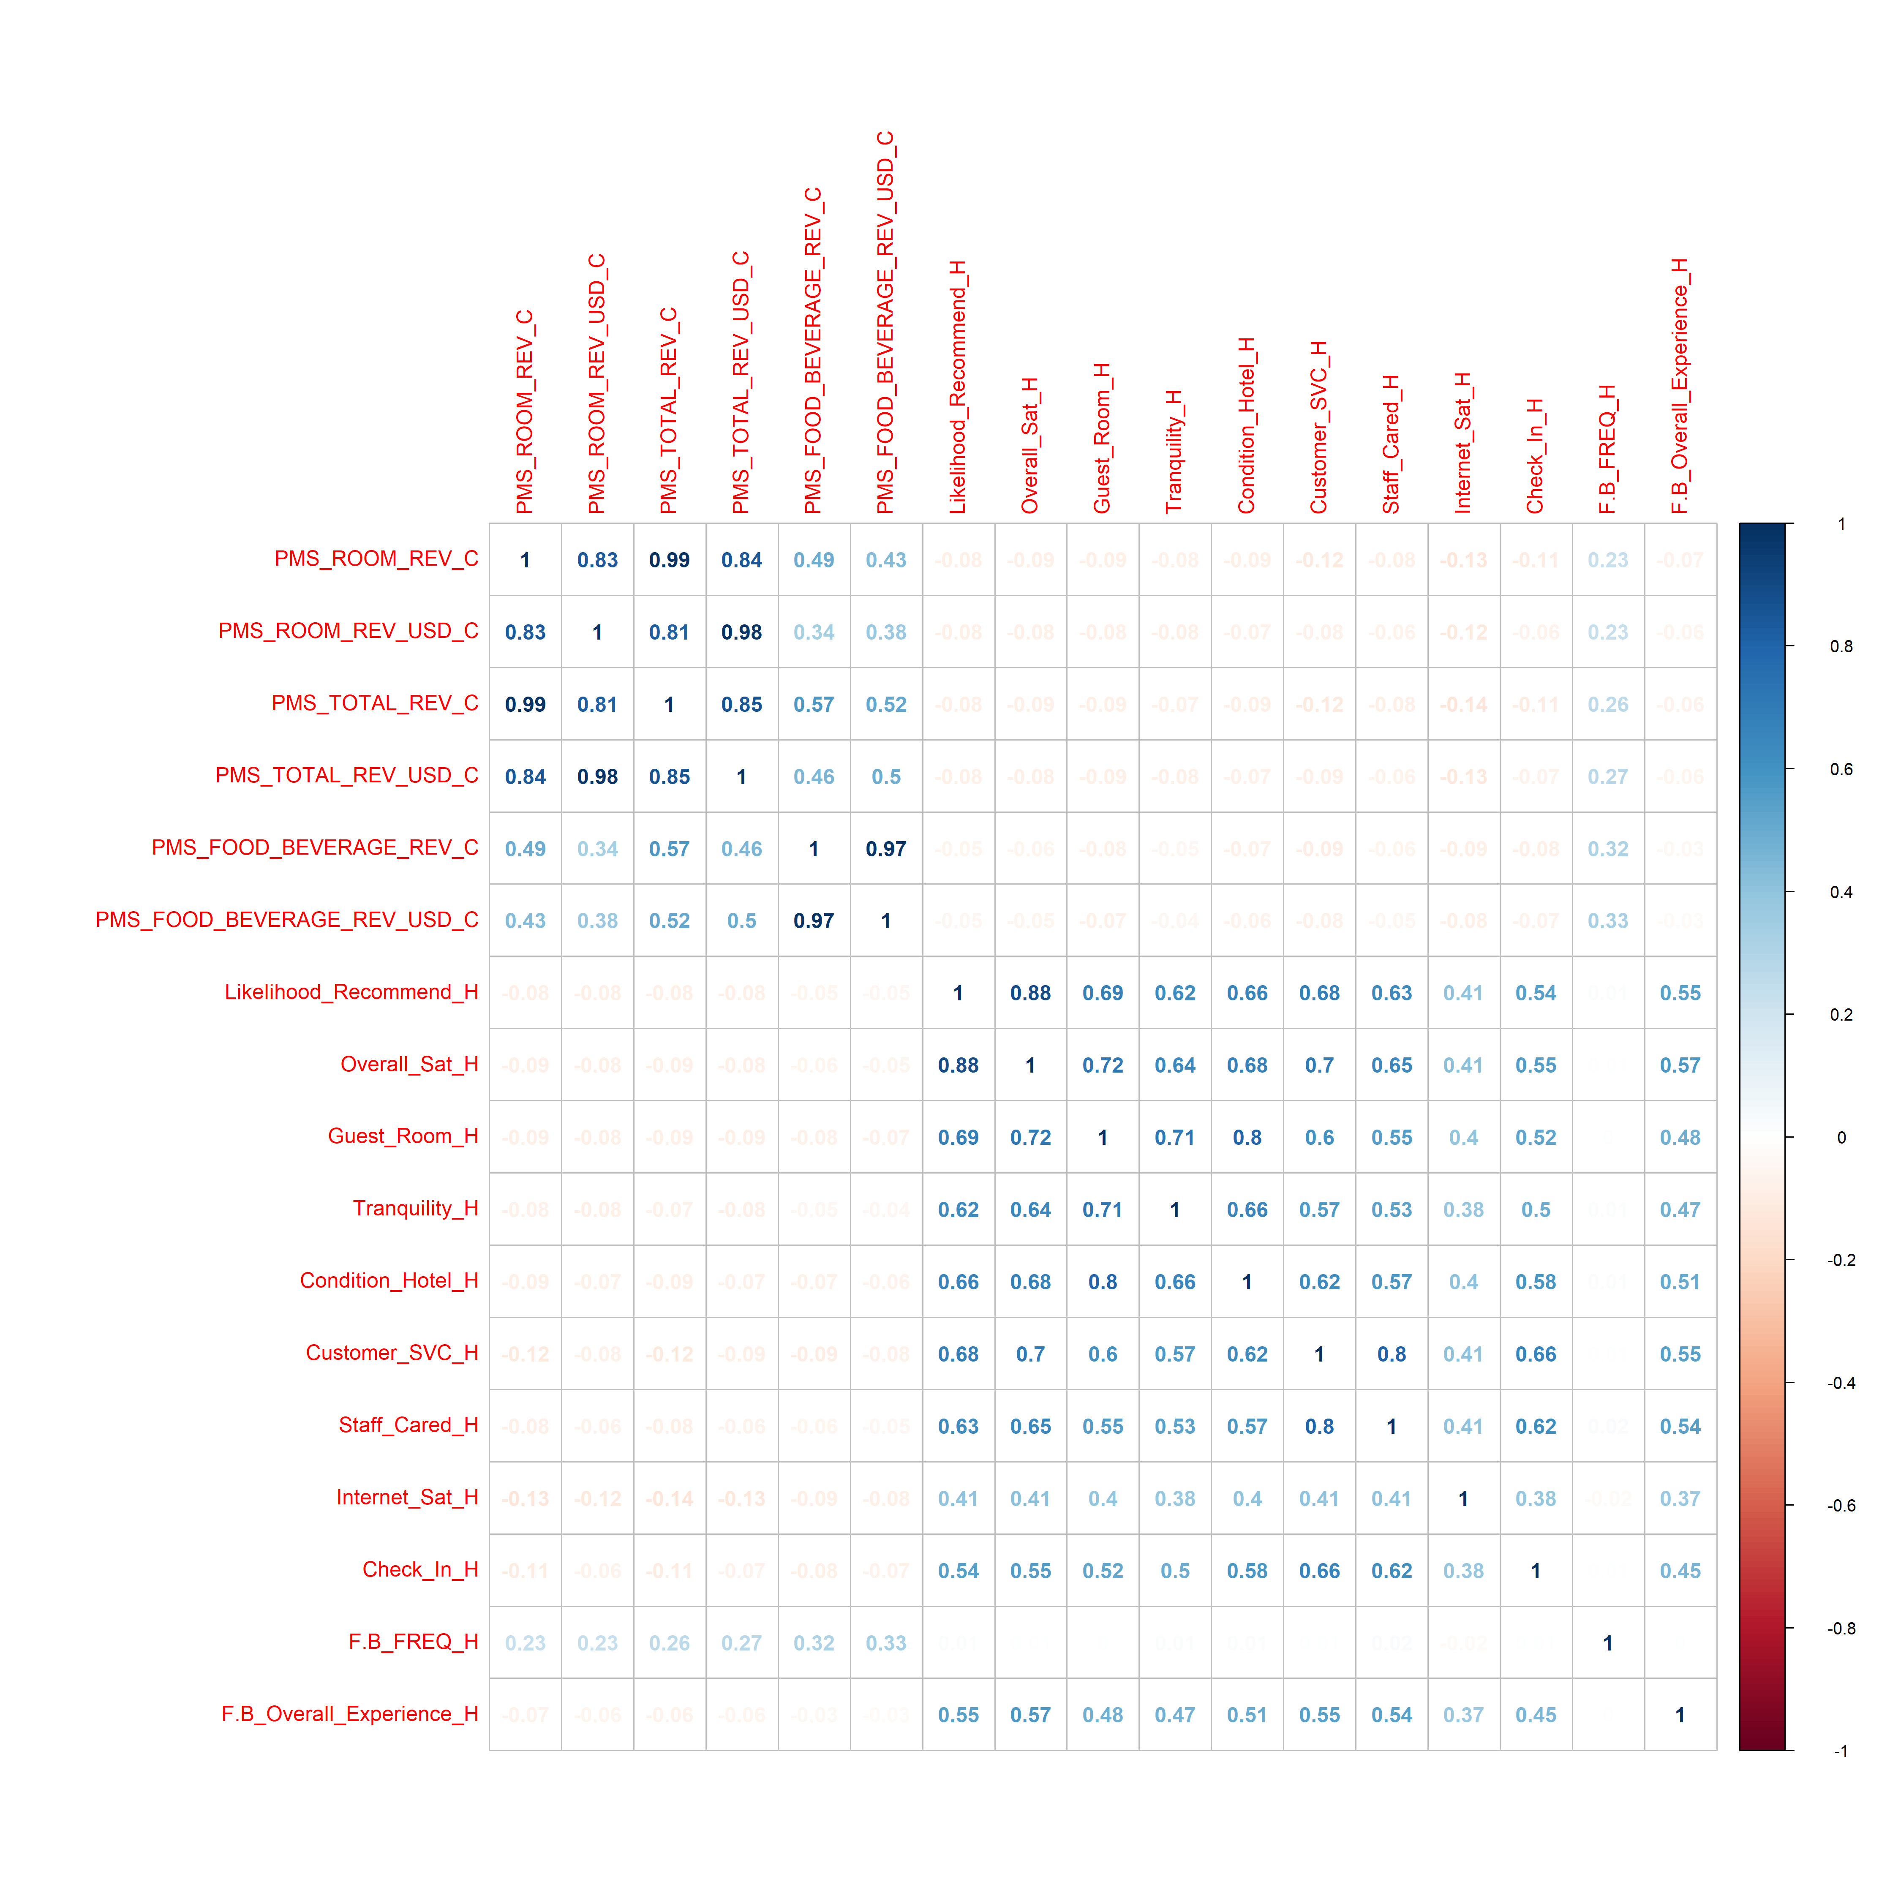
Correlation Modelling
Staff Cared ratings is highly correlated to customer service ratings
Guest Room ratings is highly correlated to tranquility
Recommendations
Conducting staff training seminar will help both customer service and staff care rating
Putting up noise reducing barriers can improve both tranquility and guest room ratings

Slide 13
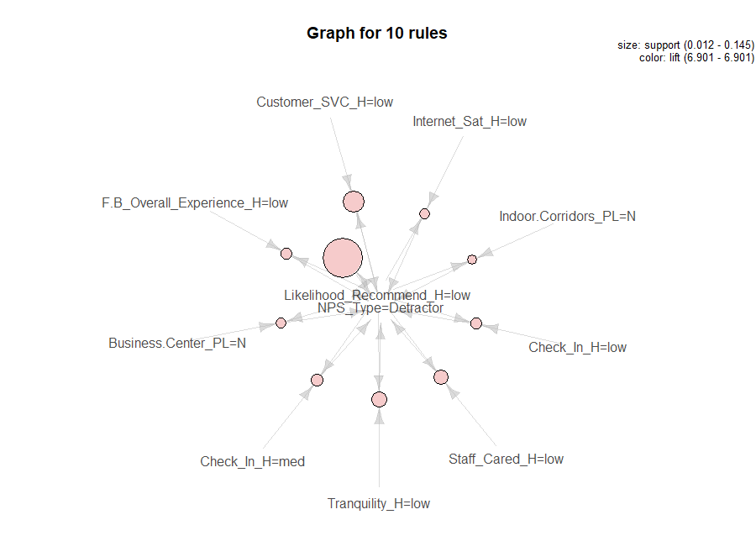
Association Rules Mining
Found out which attributes frequently occur with the word detractor
A person is likely to become detractor when he rates the hotel low on customer service, internet satisfaction, staff care, check in service and food & beverage service
The non availability of a business center and indoor was frequently associated with detractor
Recommendations
Giving free uninterrupted wifi will help improve the satisfaction of users in California
Setting up business centers and indoor corridors might help improve ratings

Slide 14
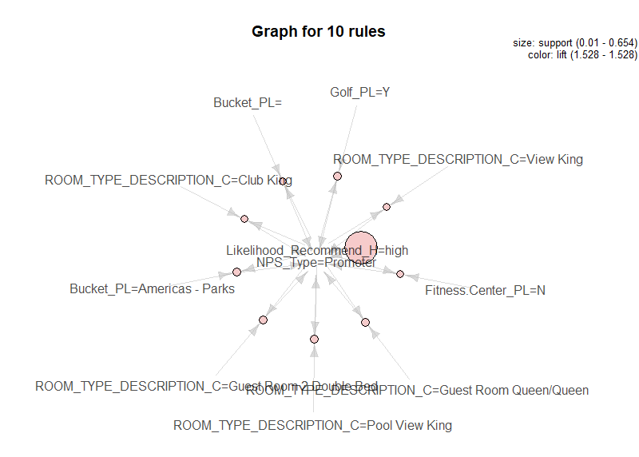
Association Rules Mining
Found out which attributes frequently occur with the word promoter
A person is likely to become promoter when he stays on club king, view king, guest room queen, guest room double bed or pool view king
Recommendations
Having more of such rooms in hotel will improve customer experience

Slide 15
SVM
Recommendations

Slide 16
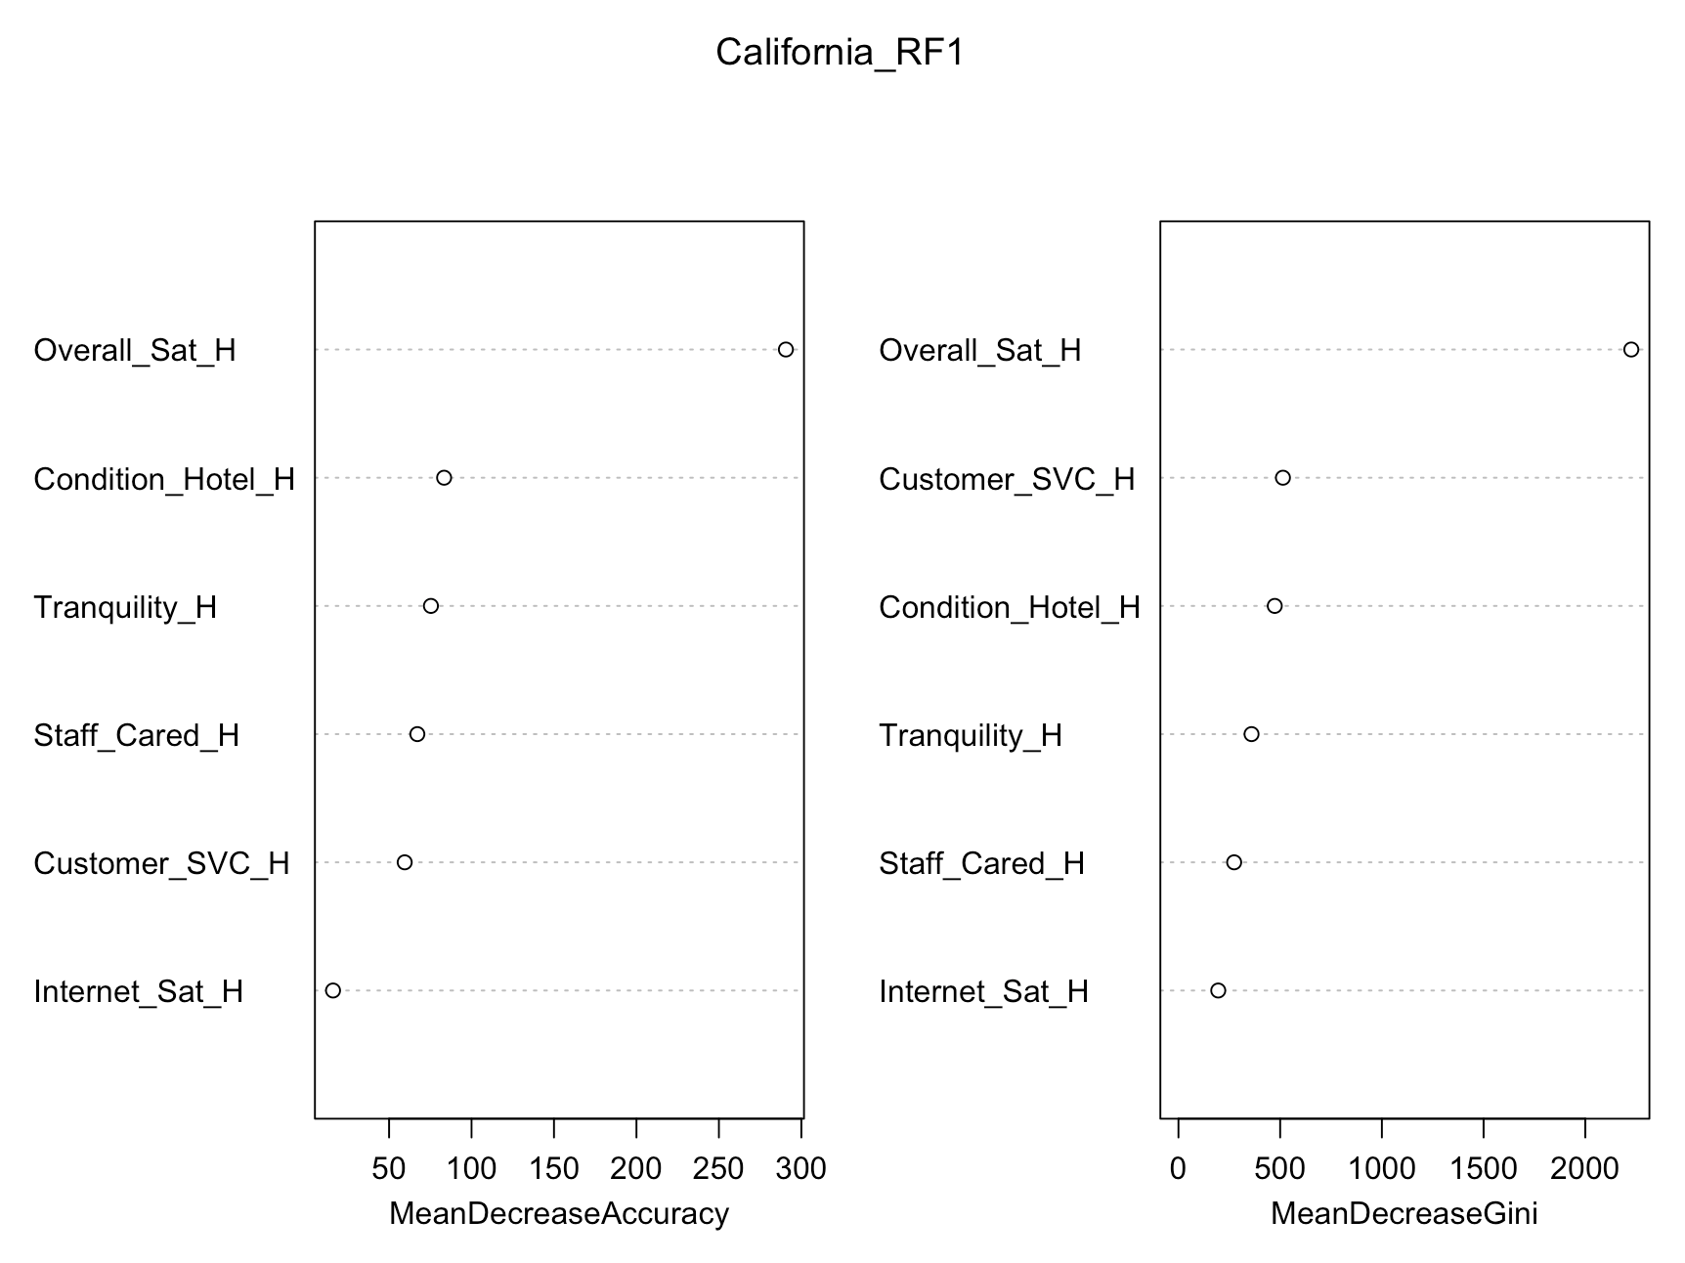
RANDOM FOREST
Recommendations

Slide 17
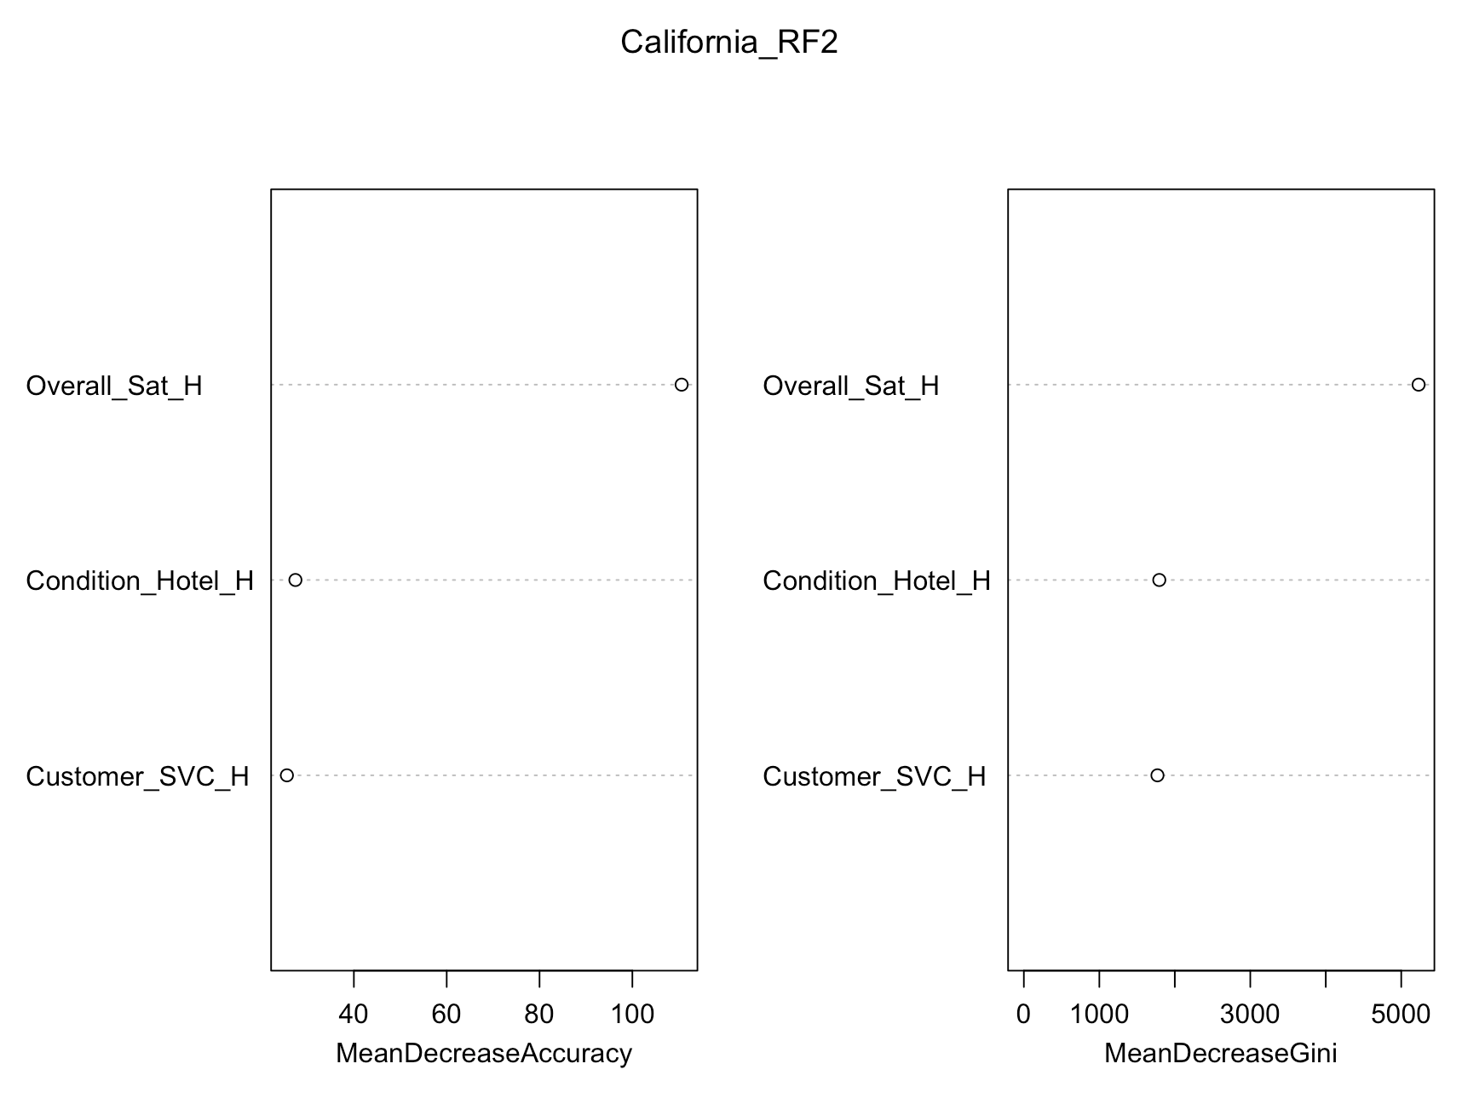
RANDOM FOREST
Recommendations

Slide 18

THANK YOU

